Slide 1
CONNECTING PEOPLE THROUGH A MOBILE SOCIAL NETWORK
DAT VU NGUYEN
Northwestern Polytechnic University
October 2013

Slide 2
Content
Introduction
Objective
Design Architecture
Accomplishment
Future Research
Question and Answer

Slide 3
Introduction
Online social network has become popular and indispensable for human life.
Online social network has two types: public social network and private social network.
Public social network is open to public to serve big communities of users. It provides a several of general and common features to interact and share common interests. For example, Facebook is a public online social network which serves a huge community of users.
Private social network serves small closed groups such as family members, employees, partners, or colleagues. It provides dedicated features to privates groups such as sharing and tracking locations, sharing books, upload files of school projects, practice programming, and so on. For example, Edmodo private social network is designed for use in education. With Edmodo, teachers can control student chatter on the main classroom page. Students can upload files of school projects. Edmodo also has a feature to ensure that no student will forget to study for tomorrow's quiz once he or she has left school.

Slide 4
Introduction
Tracking location allows a user tracking location of other users who are carrying a built-in GPS mobile device. For example, Facebook has a function to see locations of other users, but only one user at a time.
Tracking location feature is more useful if it is not limit tracking one user at one time, but also tracking multiple users at a time. It also supports group management which allows a user manages targets into groups for monitoring their locations.

Slide 5
Introduction
With the growing number of mobile platforms, mobile application development for multiple platforms becomes more complex and consumes more time and more money for labors.
To relieve this scenario, cross mobile platform solution emerges as a good solution. It reduces cost and shortens time of mobile application development.

Slide 6
Introduction
For the server application deployment, cloud computing becomes popular.
Cloud computing has some advantages such as
Cost Efficiency
Flexibility, Convenience and Continuous Availability
Scalability and Performance
Resiliency and Redundancy
Backup and Recovery

Slide 7
Objective
Develop a private mobile social network service that is based on the cloud server, instead of a local server.
Design an extensible architect which is able to be extended to support additional features without re-writing the core APIs.
Build some features that would connect the people via the online social network with ease, including the core features such as chatting and location tracking and some extended features such as Python Fun, Car Trace, Earthquake Info.

Slide 8
Objective
With the tracking location feature, users are able to track one or multiple other users at same time. It also supports group management to manage users into groups.
Support multiple device platforms by using cross mobile platform solution.

Slide 9
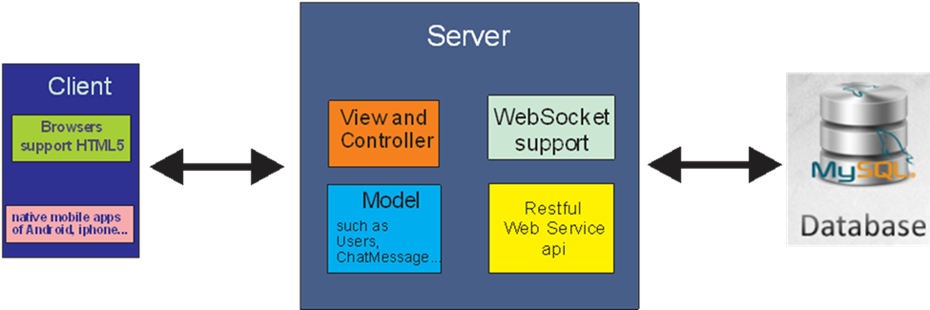
Architecture Design
Project architecture has three parts.
Client part
Server part
Database part

Slide 10
Model
View and Controller
The “Model” module contains all of classes which are used for Object-Relational Mapping (ORM) with tables in the database such as Users.java mapping to Users table, and represents chat messages such as ChatMessage.java.
The “View and Controller” module contains all of HTML, Javascript, jQuery mobile, and Java codes which provide views to clients and communicate with the database.

Slide 11
Restful Web Service
WebSocket
The "Restful Web Service API" module contains all of URI methods which are used by “View and Controller” module. All of URI methods are used to manage all of the tasks between clients and the server such as chatting, tracking location, turn on and off broadcast location option, group management, make friends, change password and so on.
The “WebSocket support” module contains codes which are used to support WebSocket in the chat and location feature. It is used to push messages among users and notify location change to users. Users don’t need to send request at interval time (polling technique). This module is written by using Java EE 7.

Slide 12
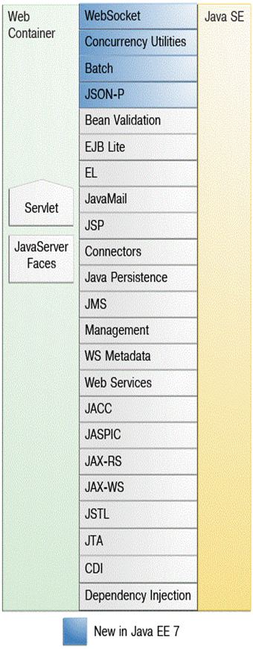
WebSocket
Java EE APIs in the Web Container

Slide 13

WebSocket is server-side push technology.
With HTTP, by nature, the server cannot push data to clients. Every time clients want to get the most updated data such as stock prices, news, weather information, or traffic, they need to send an HTTP request to the server and wait responses from the server.
Polling is one of techniques to provide real-time web applications and it simulates server-side push technology.

Slide 14
Polling means a client makes a request to the server with interval timed synchronous call to check if there is any information available for it. The client receives a response, regardless of whether data is new or old.
However, real-time data is un-predictable.
With polling technique, unnecessary requests from clients could happen. Needless connections are inevitable.

Slide 15
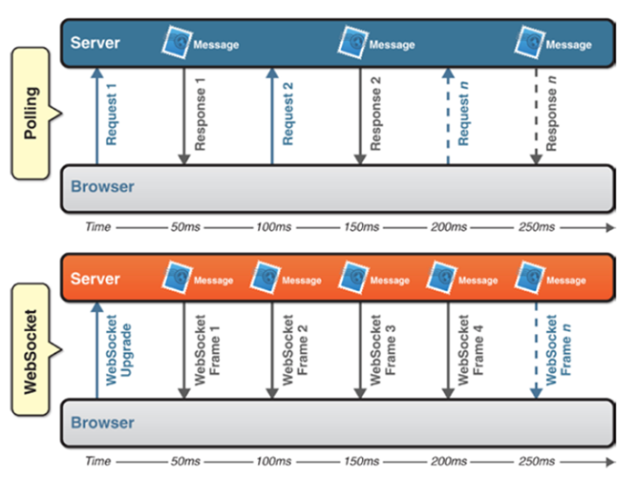
WebSocket emerges to eliminate these issues.
WebSocket provides a significant reduction in needless network traffic and latency compared to the polling technique.
WebSocket vs Polling

Slide 16
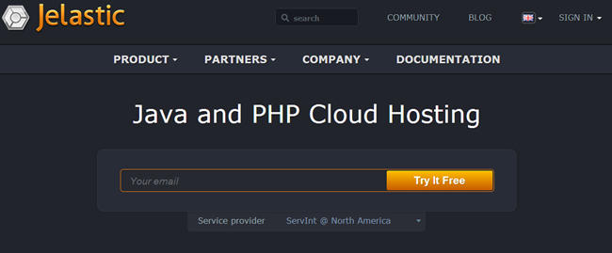
Cloud Selection
Server part is built as Java web application. It is pushed to a Java Cloud Platform cloud to serve the client.
One example of Java Cloud Platforms is http://jelastic.com/

Slide 17
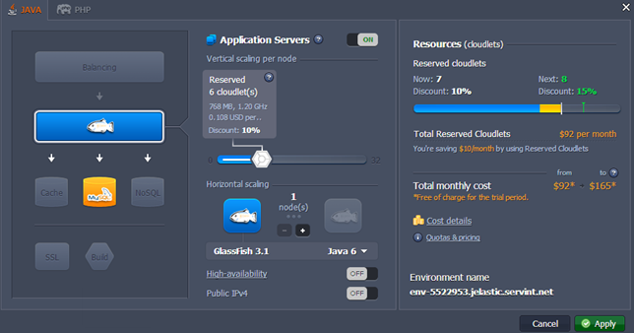
Cloud Selection
The cloud gives users Application Server such as GlassFish, and database server such as MySQL.
Users can upload their applications to those servers and run them.

Slide 18
Cloud Selection
The application server must support Java EE 7 which supports WebSocket.
In the figure, the application server GlassFish version 3.1 supports Java EE 5 and 6.
To solve this problem, users should contact the cloud support department, or try other Java Cloud Platform clouds.

Slide 19
Cloud Selection
Another option to push the server part the cloud is by using IaaS. With the above PaaS solution, the provider supports only two application servers: Tomcat and GlassFish.
For example: If the users don’t want Tomcat and Glassfish, they want Oracle WebLogic Server. They can use Iaas to setup whatever applications and database servers they want.

Slide 20
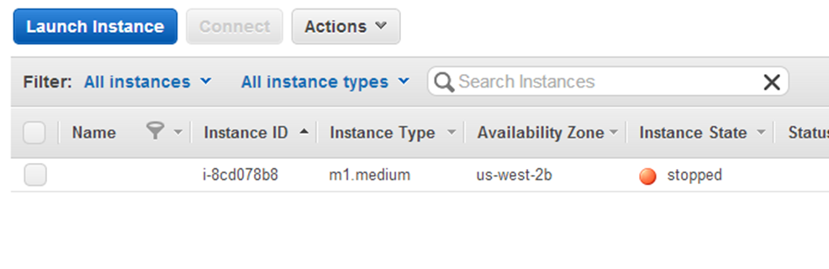
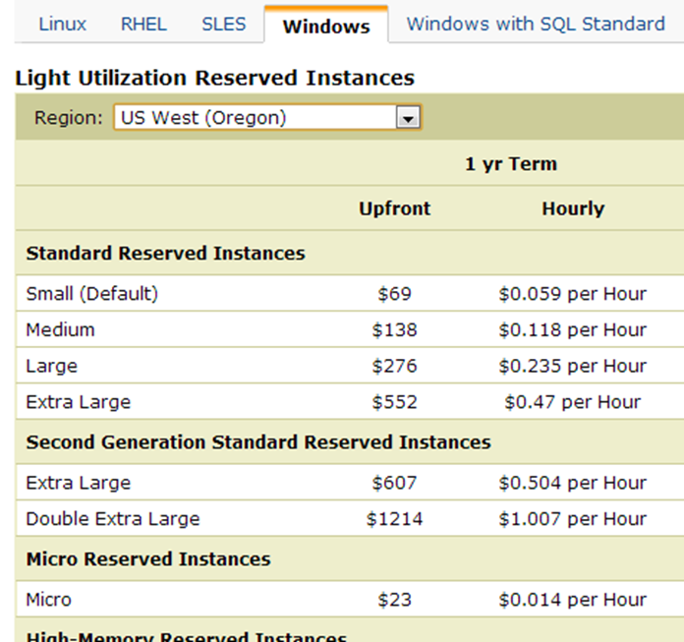
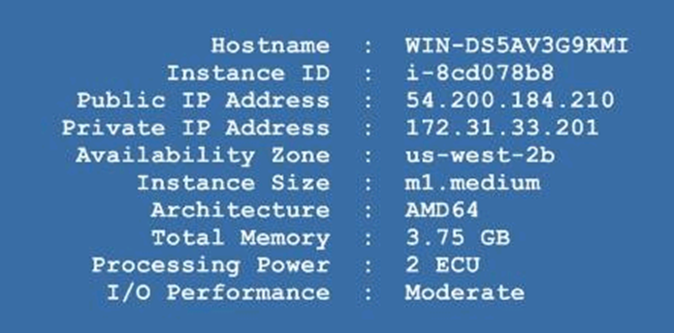
Cloud Selection
IaaS: Amazon EC2

Slide 21

HTML5 Browser
To connect and use all of features provided by the server part, users have to use browsers support html5 (which supports WebSocket).
Browsers get the code from “View and Controller” module of the server part.

Slide 22
Native Mobile Application
Besides browsers, users can use the client mobile application to communicate with the server part.
The client mobile application supports multiple mobile platforms such as Android, iPhone, Windows and so on.

Slide 23
Cross Mobile Platform
With the growing number of mobile platforms, mobile application development for multiple platforms becomes more complex and consumes more time and more money for labors.
To relieve this scenario, cross mobile platform solution emerges as a good solution.

Slide 24
Cross Mobile Platform
The cross mobile platform solution helps to:
Reduce cost of application development
Shorten time to develop applications
Deliver consistent user interface experience to customers (Unified UI Across All Mobile Platforms)
Also, code maintainability and test takes less time because one source code is taken care of instead of each source code dealing with each platform.

Slide 25
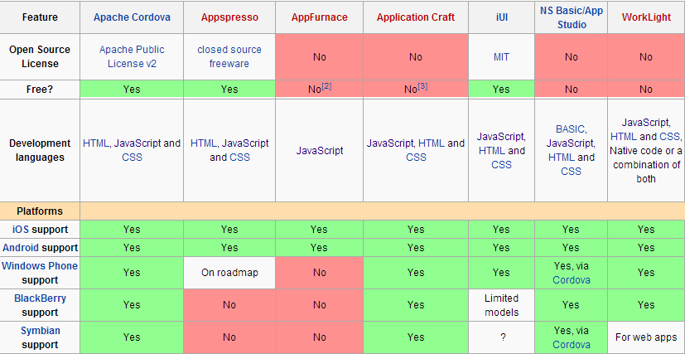
Cross Mobile Platform
Contribute to the cross mobile platform solution is the multiple phone web-based application frameworks such as Apache Cordova (PhoneGap), Appspresso, AppFurnace, Appcelerator Titanium, QuickConnectFamily, and so on.

Slide 26
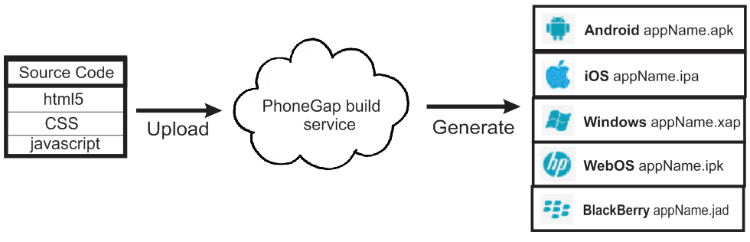
Phonegap
Use Phonegap framework in this project because it is popular, open source, good documentation, and provides PhoneGap Build Service.
PhoneGap Build Service helps developers save time of compiling HTML5, CSS, and JavaScript code into applications for other mobile platforms.

Slide 27

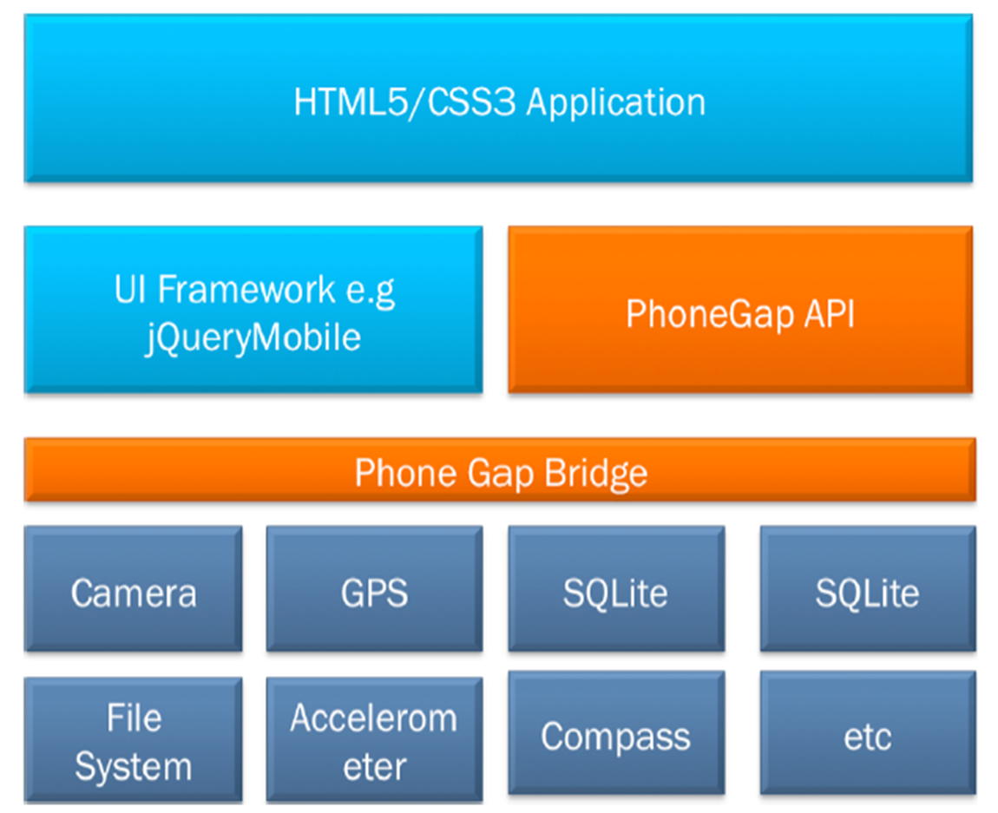
PhoneGap Architecture. Two parts.

Slide 28
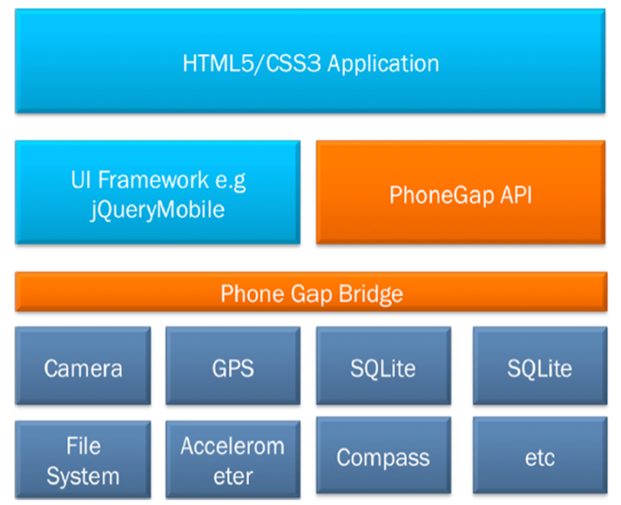
The first part is UI and functional part. For the UI, developers can build the entire UI by using HTML, JavaScript, and CSS, or they can use available frameworks such as jQuery Mobile to build our application easily and quickly .
The second part is independent PhoneGap API which allows developers to interact with the important native parts of mobile devices, such as the camera, compass, network, storage and so on.

Slide 29


All of View codes in “View and Controller” module are compiled into the native mobile applications, such as Android, by PhoneGap framework . So, I don’t need to write other specific codes for other specific mobile platforms.

Slide 30
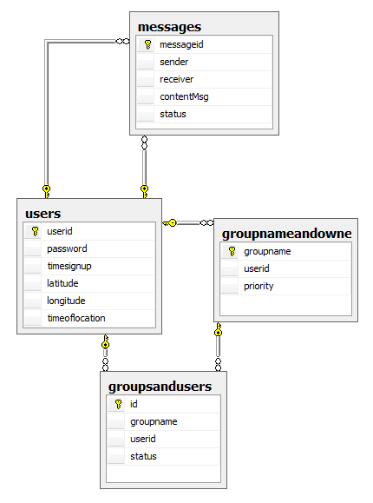
Database Design
Four tables as the figure.

Slide 31
Group Features
Only members, in a same group, can chat, share, and track each other ‘s locations.
Each user has one “Friends” group. After a user successfully makes friends to other users, the other users will be put in “Friends” group.
Each user can create groups and becomes groups’ owner.
Users can join many different groups. To join a group, a user sends a request to the group owner. At that time, the user is added to table with status value “waiting accepted”.

Slide 32

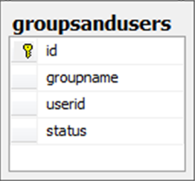
If the group owner accepts the request, the status value is changed to “accepted”
If the group owner denies the request, the user is removed out of table.
The group owner is able to delete a user from his or her group even he or she accepted the joining request before.
The group owner is able to delete his or her own group.

Slide 33
Accomplishment
The server module has been deployed on cloud amazon EC2.
The clients can use browsers or a client Android application to communicate each other via the server module.
The server module supports core features such as Group management, Chat, Tracking Location, and extended features such as Python Fun, Car Tracking, Earthquake Info.

Slide 34
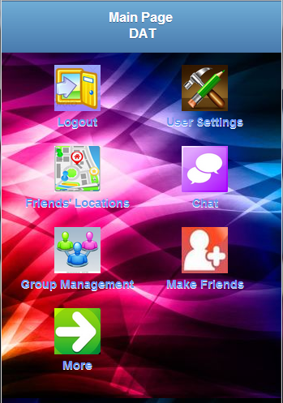
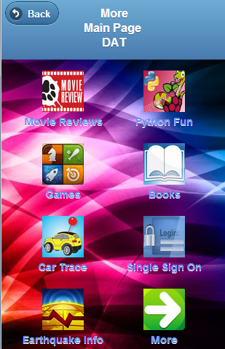

Main Page
After log in successfully, the logged-in user has some icons to interact such as Group Management, Chat, Friends Locations, User Settings, Make Friends.
Clicking More icon, users can go to next page of features.

Slide 35

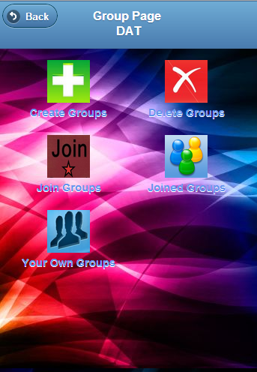
Group Management
The Group Management option has 5 icons: Create Groups, Delete Groups, Join Groups, Joined Groups, Your Own Groups.

Slide 36
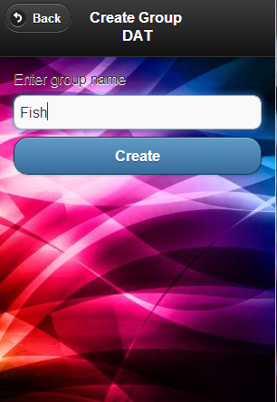
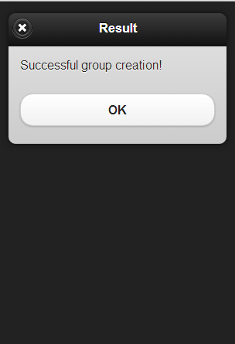

Create Groups
Users can create groups by clicking Create Groups icon

Slide 37
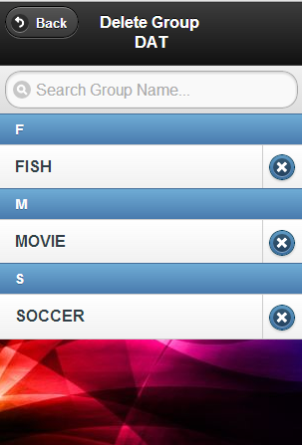
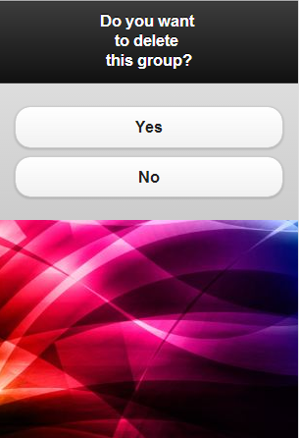
Delete Groups
Users can delete groups by clicking Delete Groups icon

Slide 38
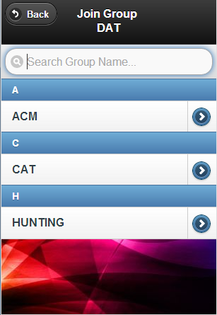
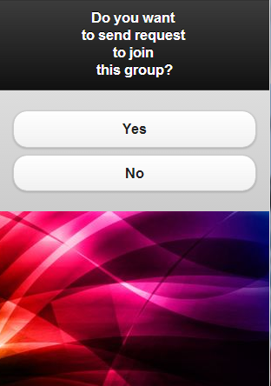
Join Groups
Users can join groups by clicking Join Groups icon

Slide 39
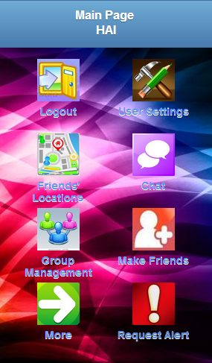

Join Groups
After a user clicks Yes, the request goes to Resquest Alert box of the group owner.

Slide 40

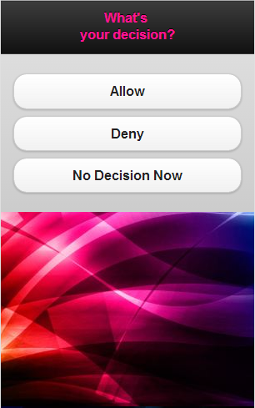
Join Groups
The group owner can accept, or deny, or decide later.

Slide 41
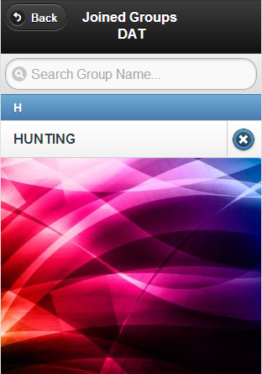

Joined Groups
Users can see groups, which they did join, by clicking Joined Groups icon. Also, users can quit groups which they did join

Slide 42
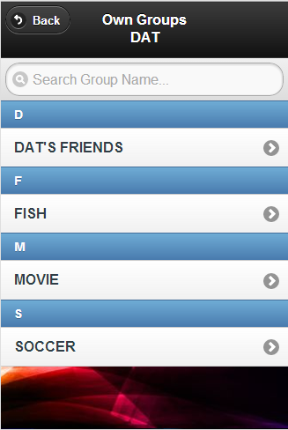
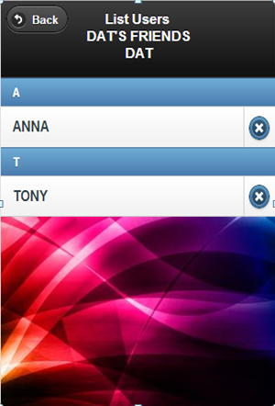
Your Own Groups
Users can see all of their own groups by clicking Your Own Groups icon. Users can also see all of members in a group.
The group

Slide 43
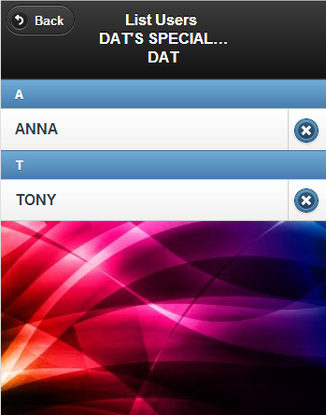
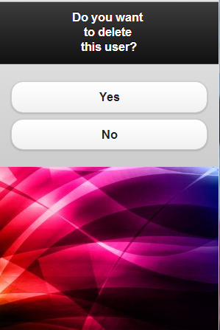
Your Own Groups
The group owner is able to delete a member out of the group.

Slide 44
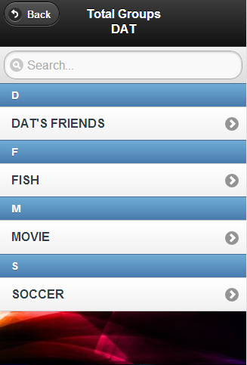
Friends Locations
The Friends Locations option provides a list of all groups which the logged-in user owns and joined.

Slide 45
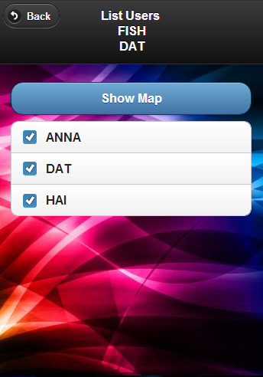
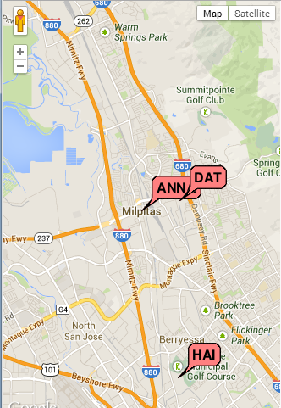
Friends Locations
The logged-in user can get all users of a group and track its members’ locations.

Slide 46

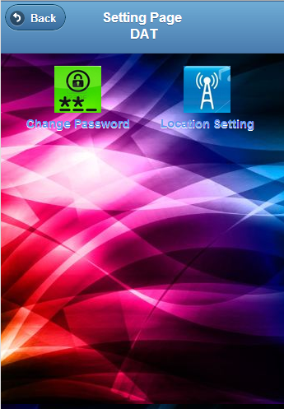
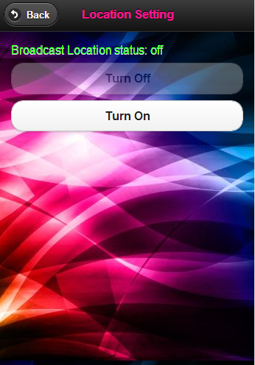
User Setting
The User Setting menu has 2 icons: Change Password and Location Setting. With the Location Setting option, a user can turn on or off broadcasting his or her location.

Slide 47
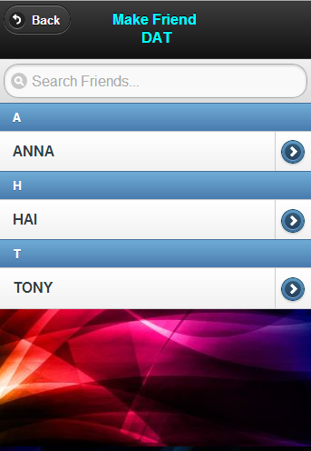
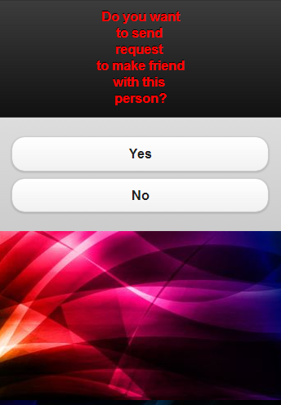
Make Friends
The Make Friends provides the logged-in user a list of all users who registered to use the server. From here, the logged-in user can make friends with other users.

Slide 48
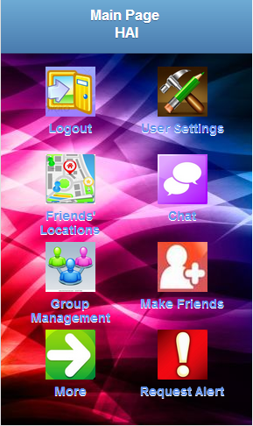

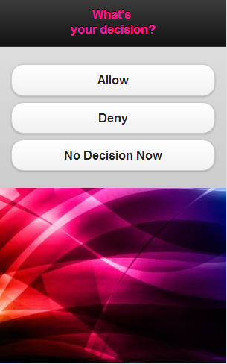
Make Friends
After Yes is clicked, the request goes to Resquest Alert box of the requested user. The requested user can accept, or deny, or decide later.

Slide 49
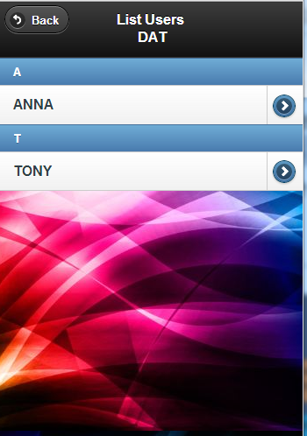
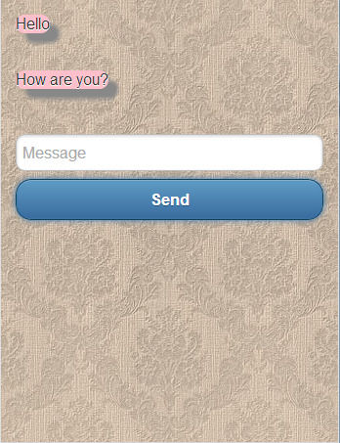
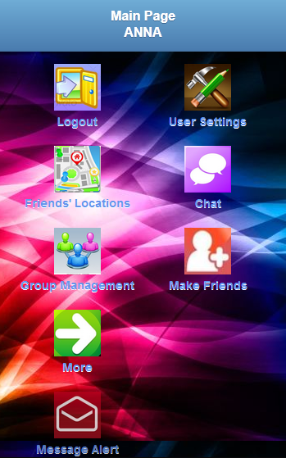
Chat
The logged-in user can send messages or chat with other users.

Slide 50
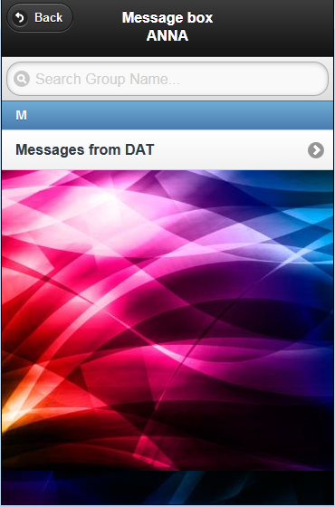
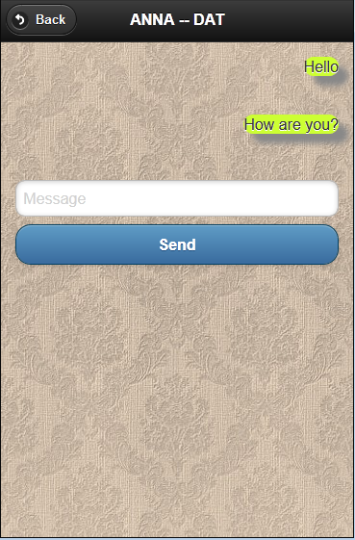
Chat
The logged-in user can send messages or chat with other users.

Slide 51
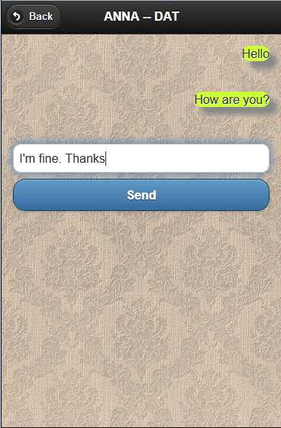
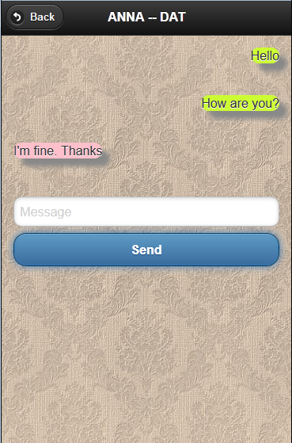
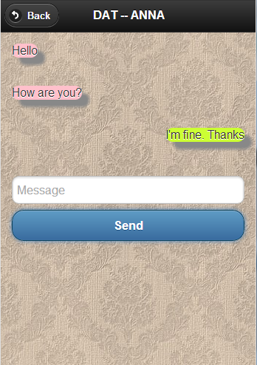
Chat
The logged-in user can send messages or chat with other users.

Slide 52
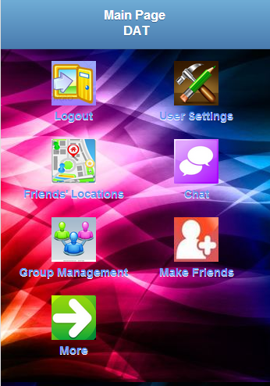
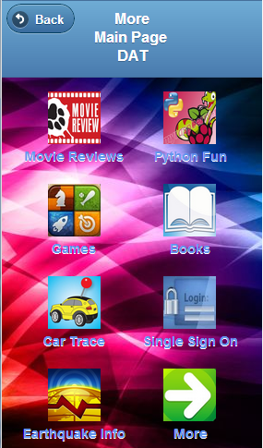
Extended Features
The application is able to be extended to support additional features. Three implemented features are added to the application: Python Fun, Car Trace, and Earthquake Info.

Slide 53
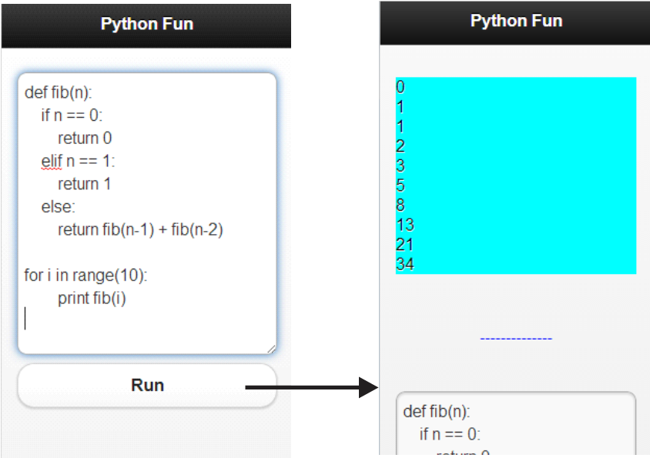
Python Fun
The “Python Fun” feature is useful for users who want to practice python by using their smartphones.

Slide 54

Python Fun
The “Python Fun” feature is useful for users who want to practice python by using their smartphones.

Slide 55


Car Trace
Car Trace feature can remember the logged-in user’s car location. This feature is useful when the logged-in user goes to the huge unfamiliar shopping mall. It is easy to forget the car parking position.
After parking the car, the logged-in user can save his or her location by clicking the button “Save Car Location”.

Slide 56

Car Trace
After shopping, the logged-in user can track his or her car location by clicking “See Car Location” button and walk to his or her car.

Slide 57


Earthquake Info
The “Earthquake Info” feature tells users the most updated information of earthquakes such locations of earthquakes, magnitudes of earthquakes, and so on.

Slide 58
Future Research
The voice chat feature is not new idea. However, if we can create cross-platform codes which support this feature, it will be very useful because it saves a lot of time to develop this feature for many platform mobile devices.
Movies, restaurant reviews or reviews of other topics feature provides users helpful information to decide what services they should use. This feature gives users many choices of reviews. Users can see an evaluation and comments from public, or from their friends, or from other evaluation services.

Slide 59
Future Research
Fall alarm feature detects accidental fall of the logged-in user. When the logged-in user falls, Fall alarm feature calls a alert to Rest Web Service. The service will send messages, which include the logged-in user’s location, to all his or her friends. More than that, the logged-in user can set up email addresses or phone numbers such as his or her nurse’s phone number and tell the Web Service send alert to them.
Location Remember feature allows the logged-in user to save any location at anywhere. This feature is suitable for users who travel, go fishing, go hiking, relocation to new place, and so on.

Slide 60



Future Research
For example, a user goes fishing. After trying some location in the river, he or she finds out a location which he or she can catch fish easily and wants to save it.

Slide 61

Future Research
Location Remember Feature
After saving a location, users can rename, delete, share, and see it on a map.

Slide 62
Question and Answer
???
Thank you

